Slide 2
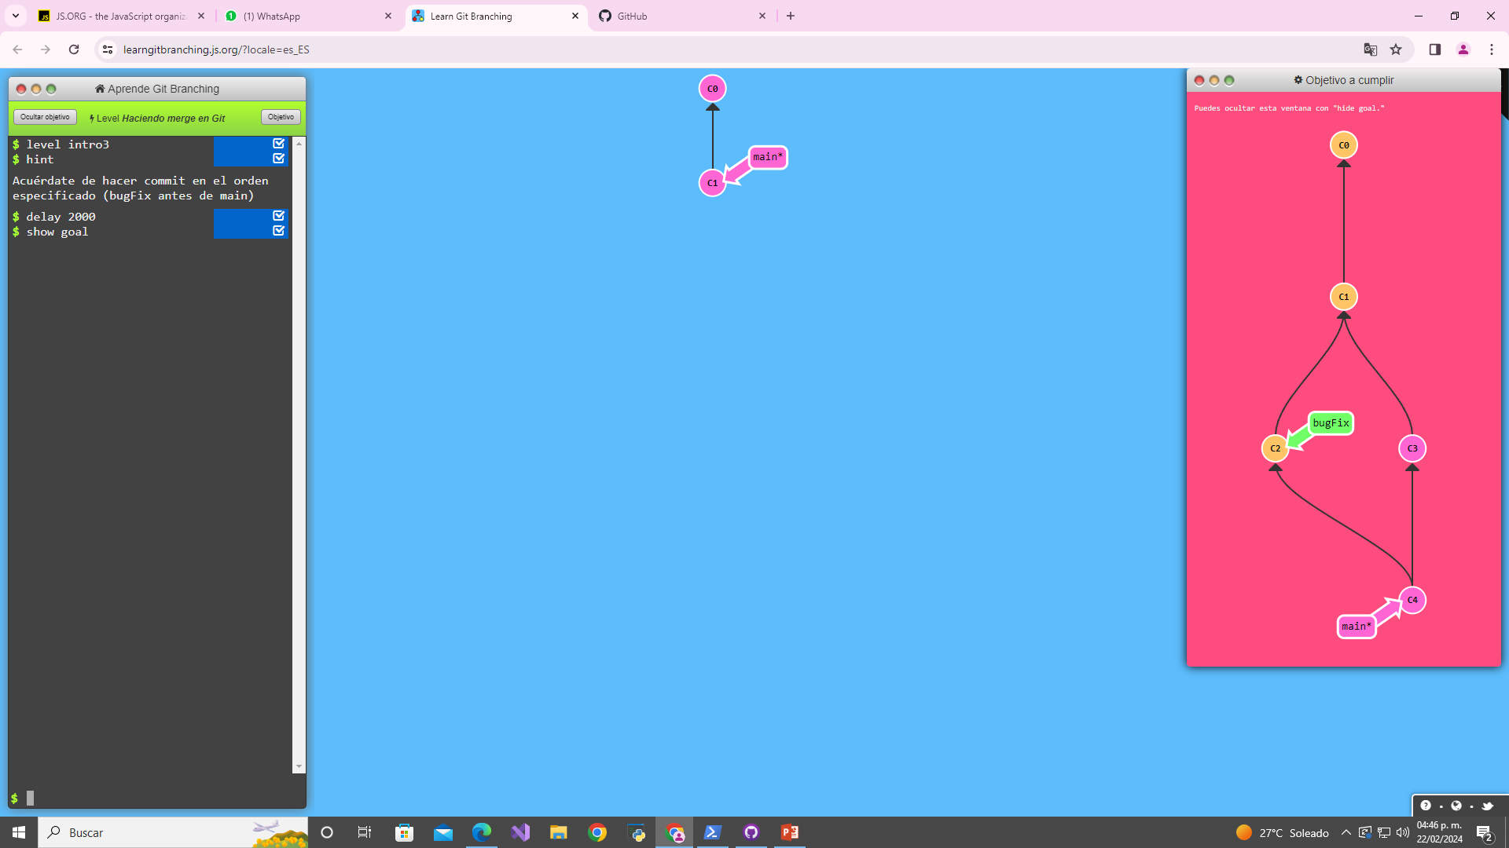
Clase3: github

Slide 3
rod00001

Slide 4
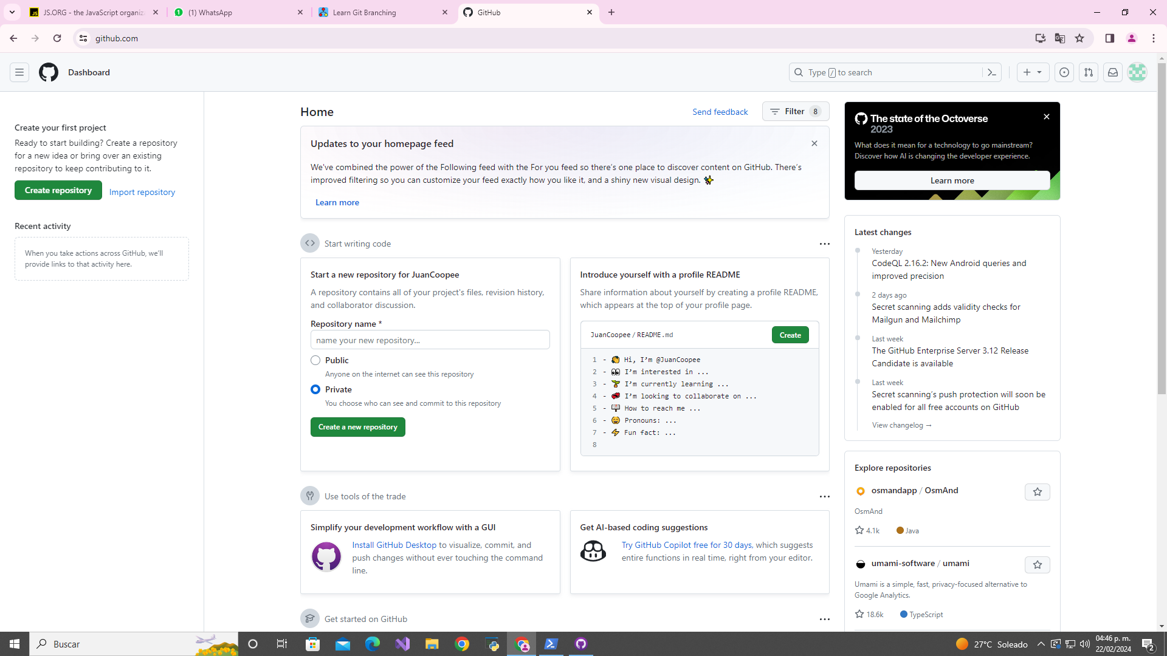

Slide 5
